Slide 1

Confidence Intervals, Effect Size and Power
Chapter 8

Slide 2
The Dangers of NHST
We already discussed that statistically significant does not always mean practically important.
Be especially skeptical if they have very large sample sizes (without any of the information presented in this chapter).

Slide 3
Women are bad at Math.
While I joke about being bad at math, I really dislike when people tell me women are not good at math.
Seriously, I was on the state math team.
Cool presentation

Slide 4
Practically Useful Numbers
So what do we do to judge a study for the practical significance?
Confidence Intervals (small = good)
Effect size (big = good)

Slide 5
Confidence Intervals
Point estimate: summary statistic – one number as an estimate of the population
e.g., mean
Just one number that an aggregate…

Slide 6
Confidence Intervals
Interval estimate: based on our sample statistic, range of sample statistics we would expect if we repeatedly sampled from the same population
e.g., Confidence interval
Tells you a lot at once!

Slide 7
Confidence Intervals
Interval estimate that includes the mean we would expect for the sample statistic a certain percentage of the time were we to sample from the same population repeatedly
Typically set at 95 or 99%
(hint that matches p<.05, p<.01)

Slide 8
Confidence Intervals
The range around the mean when we add and subtract a margin of error
Confirms findings of hypothesis testing and adds more detail

Slide 9
Confidence Intervals
Maybe a solution to the problems of NHST?
Some argue we should calculate means and CIs and if they do not overlap, that means they are different!
Only works sometimes though …

Slide 10
Confidence Intervals
The calculations are not that different than what we’ve been doing:
Take a z-score where 95% of the data is in the middle of the distribution
Translate that back to a raw score to match the mean.
(draw)

Slide 11
Calculating Confidence Intervals
Step 1: Draw a picture of a distribution that will include confidence intervals
Step 2: Indicate the bounds of the CI on the drawing
Step 3: Determine the z statistics that fall at each line marking the middle 95%
Step 4: Turn the z statistic back into raw means
Step 5: Check that the CIs make sense

Slide 12
Confidence Interval for z-test
M_{lower} = - z(σ_{M}) + M_{sample}
M_{upper} = z(σ_{M}) + M_{sample}
Think about it: Why do we need two calculations?

Slide 13
Example
Let’s compare the average calories consumed by patrons of Starbucks that posted calories on their menus to the population mean number of calories consumed by patrons of Starbucks that do not post calories on their menus (Bollinger, Leslie, & Sorensen, 2010).
The population mean was 247 calories, and we considered 201 to be the population standard deviation. The 1000 people in the sample consumed a mean of 232 calories.

Slide 14
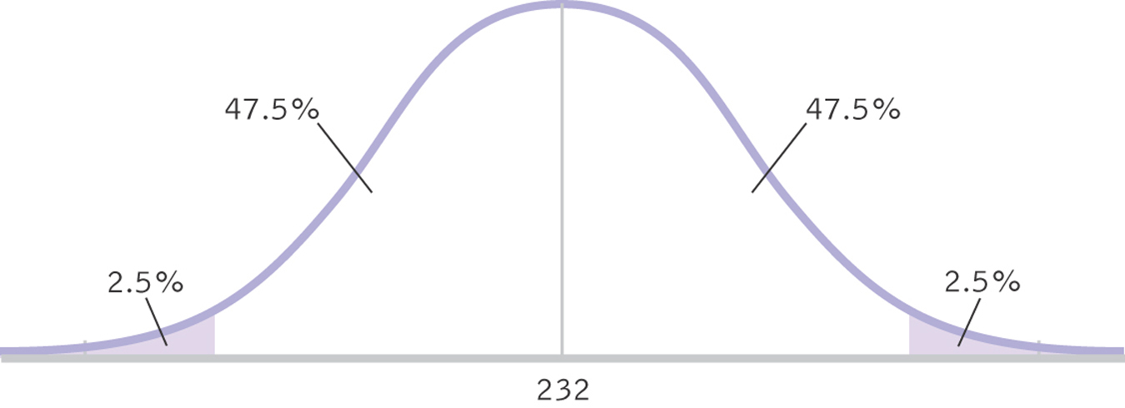
A 95% Confidence Interval, Part I

Slide 15
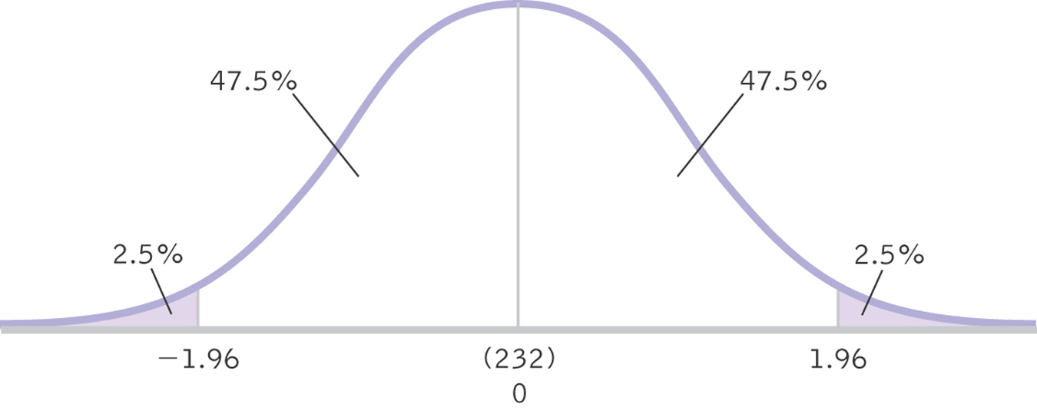
A 95% Confidence Interval, Part II

Slide 16
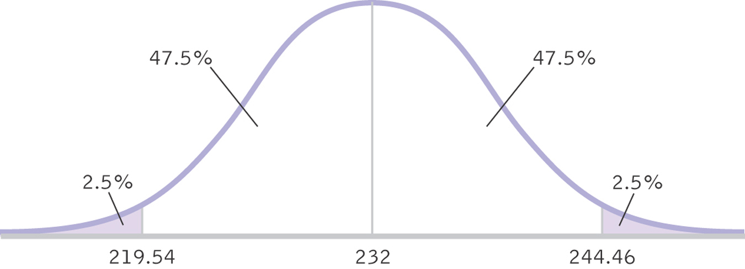
A 95% Confidence Interval, Part III

Slide 17
Think About It
Which do you think more accurately represents the data: point estimate or interval estimate?
Why?
What are the advantages and disadvantages of each method?

Slide 18
Effect Size: Just How Big Is the Difference?
Significant = Big?
Significant = Different?
Increasing sample size will make us more likely to find a statistically significant effect

Slide 19
Effect Size: Just How Big Is the Difference?
 | Small Effect Size | Big Effect Size
Fail to reject null | Probably not there, sample size not issue | Important! May not have enough people in study
Reject null | Probably not there, sample size may be causing rejection (Type 1) | Important and we found it! (power).

Slide 20
What is effect size?
Size of a difference that is unaffected by sample size
How much two populations do not overlap
Standardization across studies

Slide 21
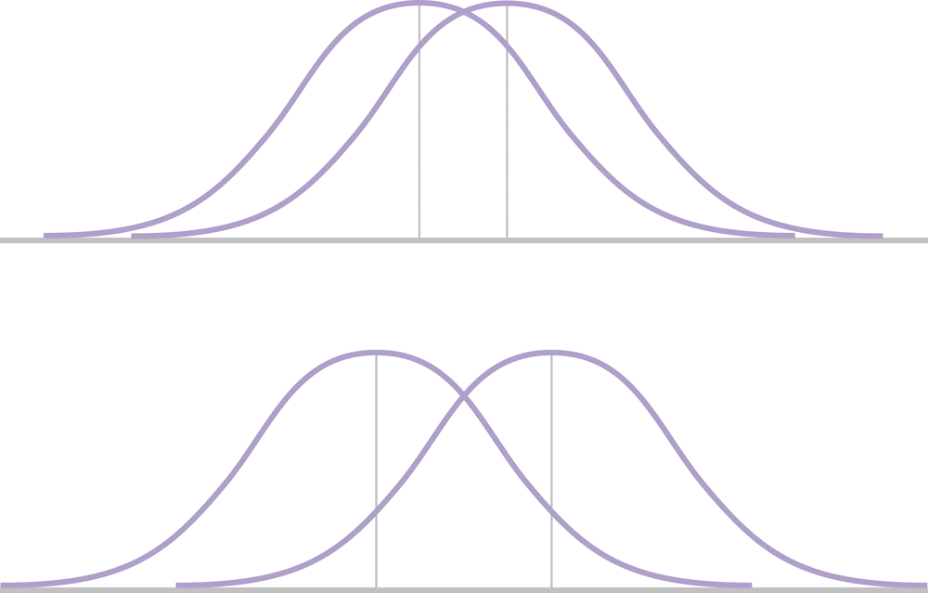
Effect Size & Mean Differences
Imagine both represent significant effects: Which effect is bigger?

Slide 22
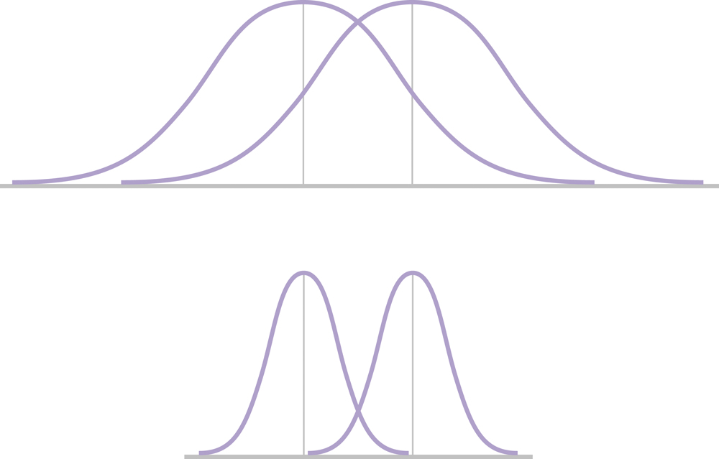
Effect Size and Standard Deviation
Note the spread in the two figures: Which effect size is bigger?

Slide 23
Increasing Effect Size
Decrease the amount of overlap between two distributions:
1. Their means are farther apart
2. The variation within each population is smaller

Slide 24
Calculating Effect Size
Cohen’s d Estimates effect size
Assesses difference between means using standard deviation instead of standard error

Slide 25
Example
Let’s compare the average calories consumed by patrons of Starbucks that posted calories on their menus to the population mean number of calories consumed by patrons of Starbucks that do not post calories on their menus (Bollinger, Leslie, & Sorensen, 2010).
The population mean was 247 calories, and we considered 201 to be the population standard deviation. The 1000 people in the sample consumed a mean of 232 calories.

Slide 26
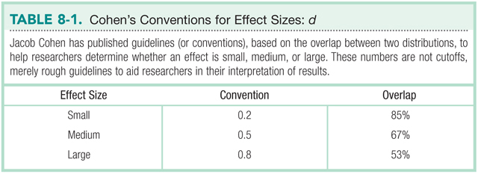

Slide 27
MOTE
Free effect size program
Created by the DOOM lab! Yeah!

Slide 28
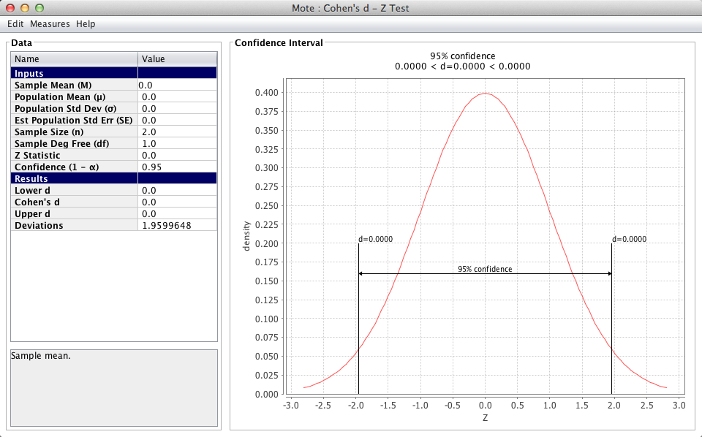

Slide 29
P_{rep}
PLEASE IGNORE THE Prep NONSENSE IN YOUR BOOK.
This book was published in 2011, well after the psychology community discovered it was mathematically flawed.
Sheesh. ☹

Slide 30
Statistical Power
The measure of our ability to reject the null hypothesis, given that the null is false
The probability that we will reject the null when we should
The probability that we will avoid a Type II error

Slide 31
Power Rangers Example
See handout!

Slide 32
Calculating Power
Step 1: Determine the information needed to calculate power
Population mean (um)
Standard error (N, o needed)
Sample mean found (M)

Slide 33
Calculating Power
Step 2: Determine a critical z value (cut off score)
Calculate raw score for that z:
Mneeded = um + (om)*z

Slide 34
Calculating Power
Step 3: Figure out the distance between the M needed and sample M you estimated
Z = (Mneeded – Msample) / om
Then the percentage of the distribution above/below that score is power
(matches your hypothesis of higher or lower)

Slide 35
What increases power?

Slide 36
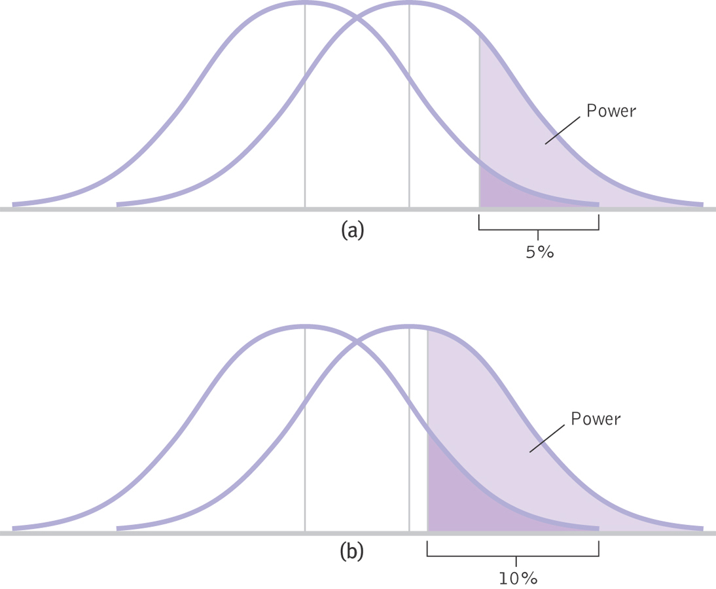
Increasing Alpha

Slide 37
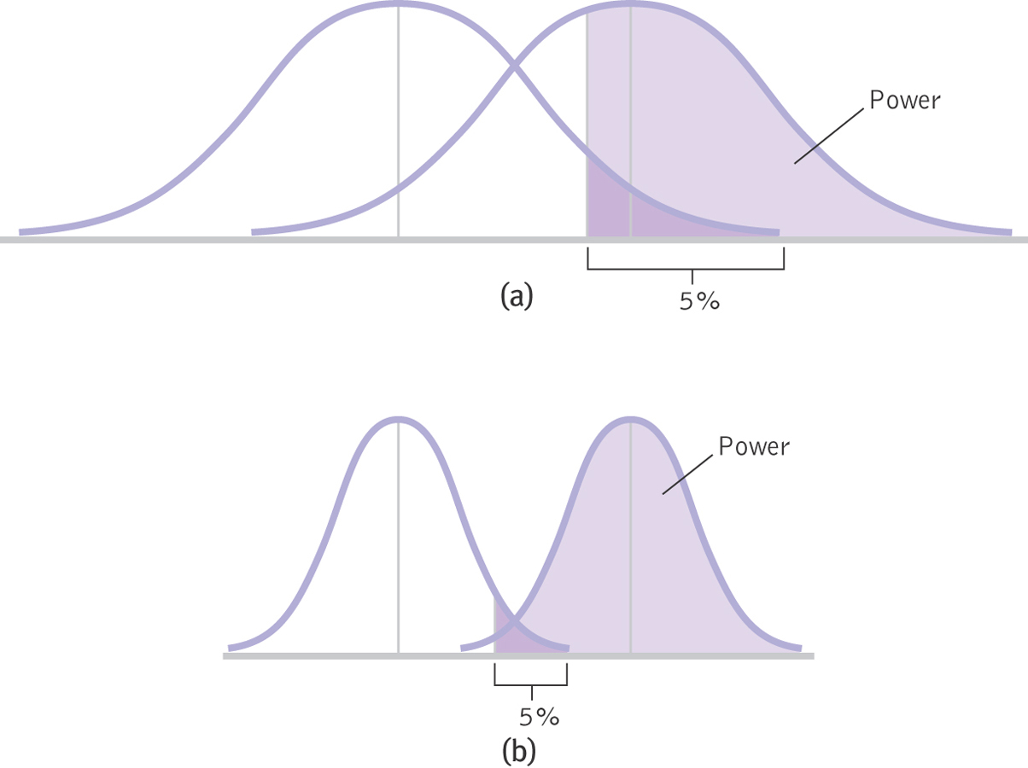
Two-Tailed Verses One-Tailed Tests

Slide 38
Increasing Sample Size or Decreasing Standard Deviation
Both of these decrease standard error

Slide 39
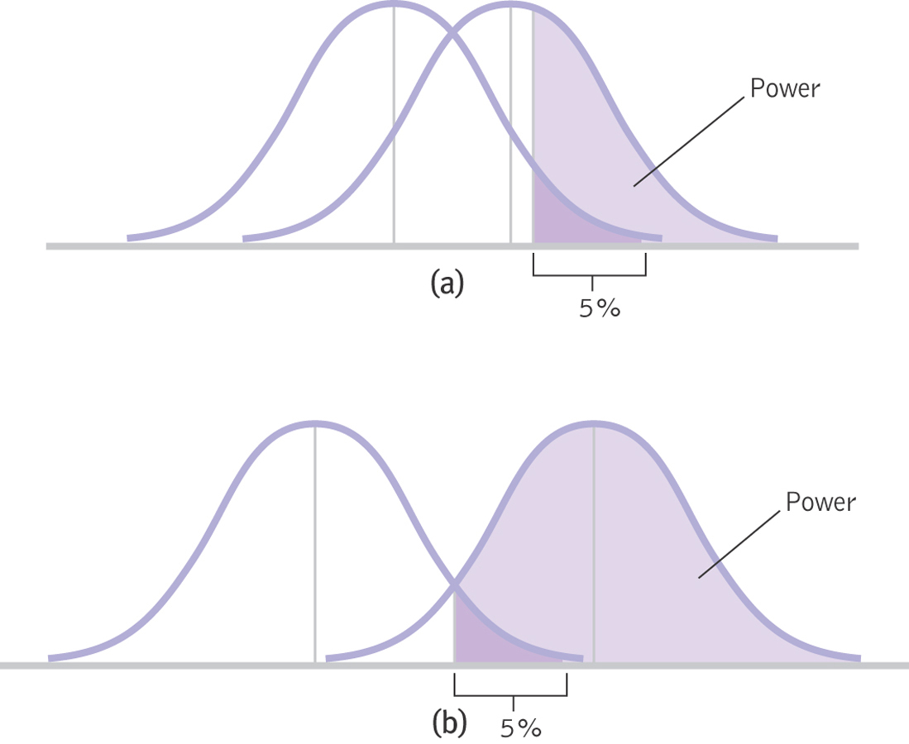
Increasing the Difference between the Means
Effect size

Slide 40
Factors Affecting Power
Larger sample size increases power
Alpha level
Higher level increases power (e.g., from .05 to .10)
One-tailed tests have more power than two-tailed tests
Decrease standard deviation
Increase difference between the means

Slide 41
Think About It
Why would it be important to know the statistical power of your study?

Slide 42
Meta-Analysis
Meta-analysis considers many studies simultaneously.
Allows us to think of each individual study as just one data point in a larger study.

Slide 43
The Logic of Meta-Analysis
STEP 1: Select the topic of interest
STEP 2: Locate every study that has
been conducted and meets the criteria
STEP 3: Calculate an effect size, often Cohen’s d, for every study
STEP 4: Calculate statistics and create appropriate graphs

Slide 44
